Slide 1

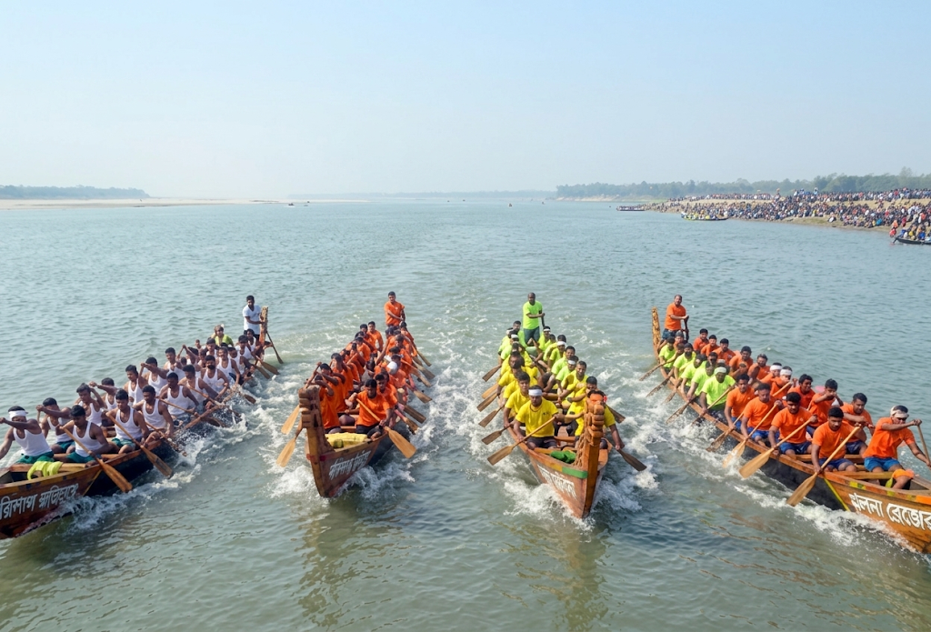
Traditional Boat Race and the Titas River

Slide 2
INTRODUCTION:
Cultural Heritage & Venue: Nouka Baich(Boat Race) is a traditional boat racing festival in Bangladesh that celebrates the country's riverine culture, with Brahmanbaria's Titas River acting as a primary natural arena.
Community & Atmosphere: The festival highlights teamwork as rowers paddle to the rhythm of folk Sari Gan, supported by enthusiastic spectator crowds gathering along the riverbanks.
OpenGL Graphical Environment: Built using C++ and GLUT/OpenGL, the code renders dynamic river waves, village huts, multi-story structures, and riverside vegetation to recreate the rural backdrop.
Interactive Day/Night System: Toggle between modes using keyboard input ('d' for Day, 'n' for Night), switching the scene between animated rowers under a sunlit sky and night-time camping tents with bonfires.
Speed Controls: Interactive mouse and key controls adjust speed dynamics, including controlling boat motion ('x' / 'y') and bird flight speed (mouse clicks).

Slide 3
Reason to chose this topic:
Vibrant Folk Tradition: Nouka Baich(Boat Race) is an ancient and colorful boat racing festival that represents the rich culture of rural Bangladesh.
The Heart of Titas: The historical Titas River in Brahmanbaria serves as a famous natural arena for hosting these grand boat races.
Teamwork & Rhythm: Rowers pull their paddles together in speed and harmony, chanting traditional Sari Gan (folk songs) to boost energy.
Mass Celebration: Thousands of spectators gather along both banks of the Titas River to cheer and celebrate the event with great joy.
Symbol of Unity: This event brings people of all backgrounds together, keeping Bangladesh's riverine heritage alive across generations

Slide 4
Key Features:
Day & Night Mode Dynamic Lighting: Toggle between a sunlit day scene and a dark night sky with stars and moon lighting using keyboard keys ('d' and 'n’).
Boat Racing & Rowers Animation: Animated racing boats with rowers synchronized to simulate the traditional Nouka Baich event.
Interactive Speed Controls: Keyboard and mouse controls to adjust boat movement speed ('x' / 'y') and bird flight animation speed.
Detailed Rural Environment Rendering: Built-in dynamic river waves, riverside village huts, multi-story buildings, and lush green vegetation.
Night Bonfire & Camping Scene: A night-time scene featuring interactive camping tents and animated bonfires along the Titas riverbank.

Slide 5
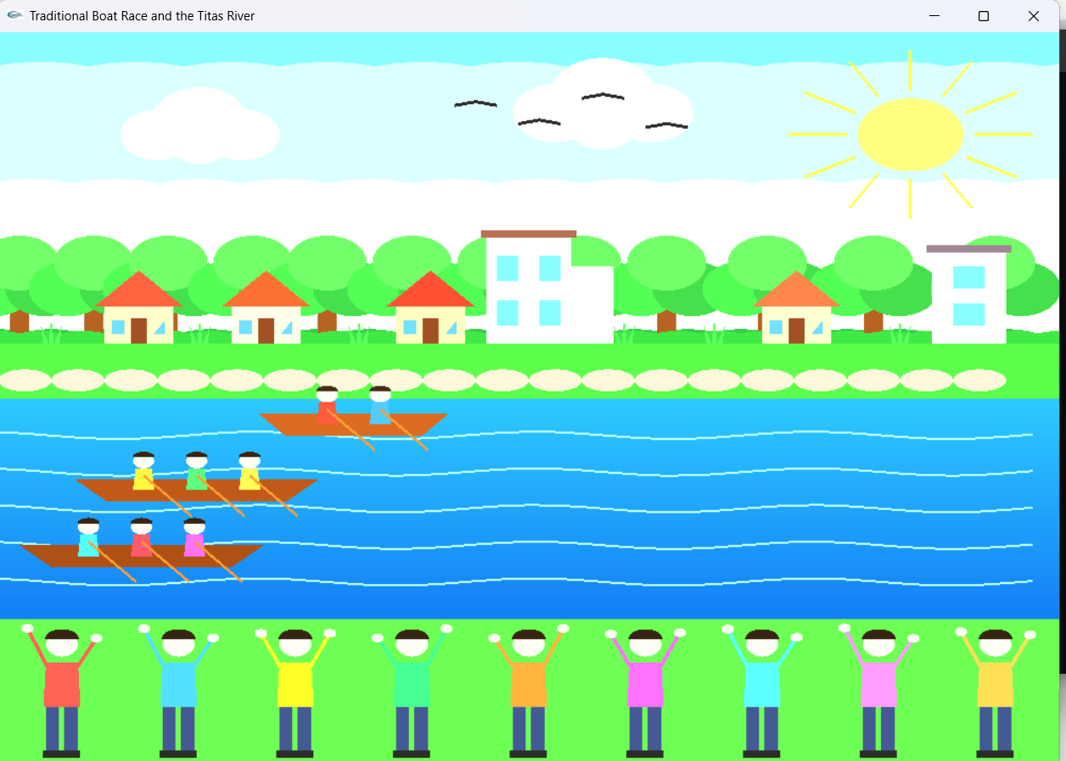
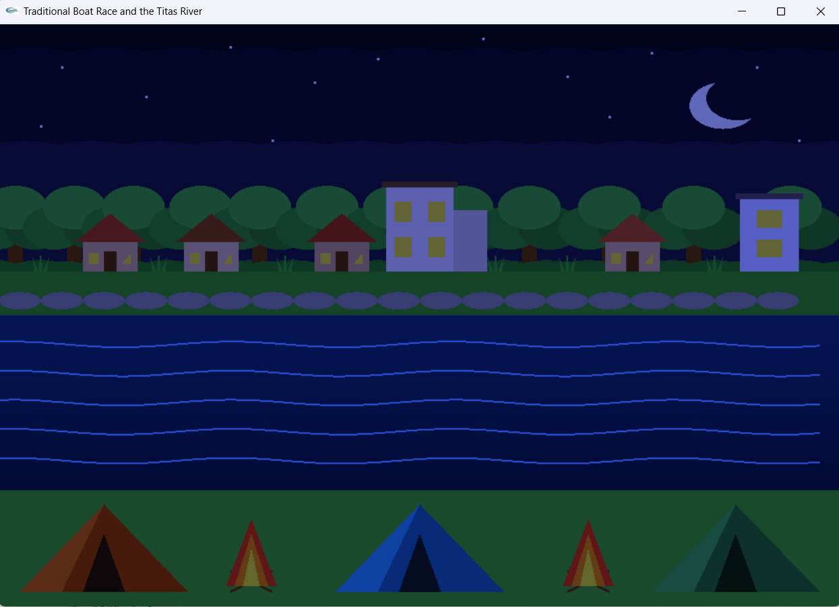
Screenshots:

